Slide 1
RoboCat- Milestone 4
ALEX VILD, QUINTIN FETTES, ZACH TAYLOR, KURTIS DAVIS, SEATTLE RUZEK, LUKE SHAYS

Slide 2
Our MVP
Continuous Voice Recognition for existing commands
Met Requirement
Empirical evidence
automated testing not feasible, tested all valid commands successfully
Color Tracking ability
Partially Met
empirical evidence
Face Tracking ability
Met Requirement
Empirical Evidence - automated testing not feasible, extensive real time testing performed
Notes:
Present

Slide 3
Our MVP
Environmental mapping: functioning sensor and mapping. The cat can’t walk, so functionality will be slightly limited
Partially Met
completion was not possible, the sensor was not installed
code to communicate with arduino works
Log accelerometer data
Met
Running the app always automatically stores accelerometer data and displays it upon command via the menu.
Add Battery indicator
Met
Screen changes based on battery level, all cases tested

Slide 4
Review
Team Meetings
Reserved ARC 106 every Monday and Tuesday throughout the semester from 6-7 PM.
Each member would review what they’ve done since last meeting and what they plan to do before the next meeting.
Would discuss issues, and the progress that the team is making overall.
Testing meetings in RoboCat lab (Stocker 302)
09/14/2016 - Miguel taught us how to attach the Android to RoboCat and how to turn on the battery.
10/15/2016 - Shot the facetracking video for the EECS Retreat, talked to Miguel about the electronics for RoboCat.
Other meetings in the lab were impromptu and involved a subset of the team to test their individual progress.

Slide 5
Client Meetings
Initial Meeting
Go over MVP and ask the questions that we prepared for the client.
EECS preparation/midway meeting
discuss progress, prepare material to present
Meetings with Miguel:
occurred frequently as time was spent working in the lab. Progress and Ideas discussed

Slide 6
Release Process
From beginning to end:
A developer will clone a branch of the repo
Make improvements to the functionality of the cat
Test branch code on the RoboCat
Merge branch with master upon successful test
At each milestone, mark a release on github. Develop apk and upload to Google Play Store
Not uploaded to store right now. It was removed from the Google Play Store due to a security vulnerability.
Notes:
Present

Slide 7
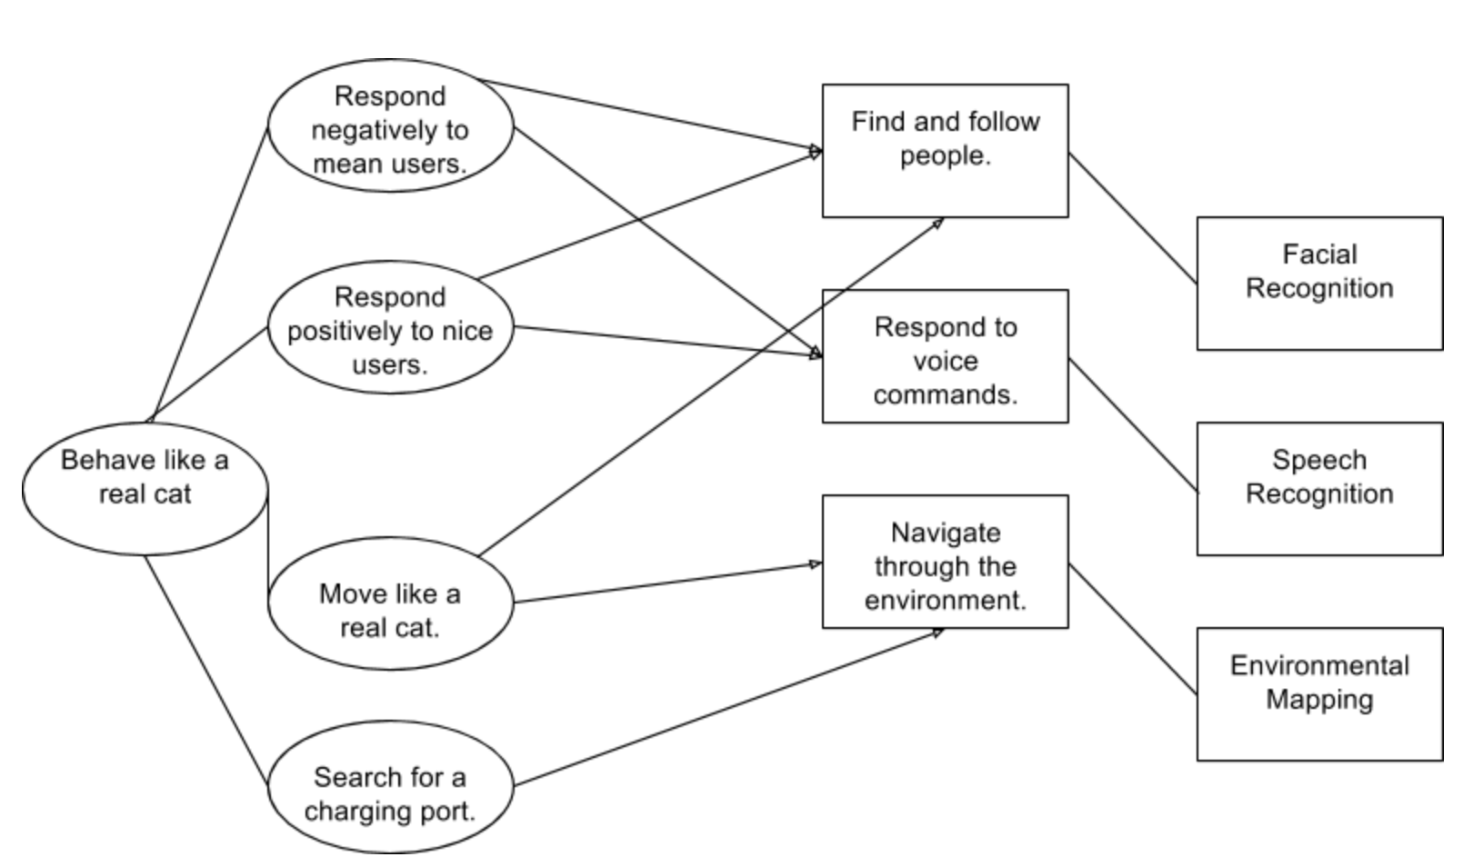
Design: Purpose-Concept Diagram

Slide 8
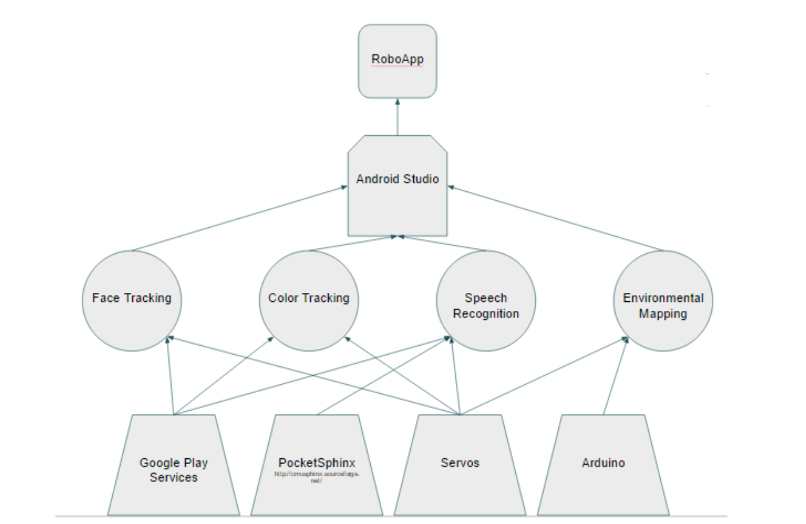
Technology Stack

Slide 9
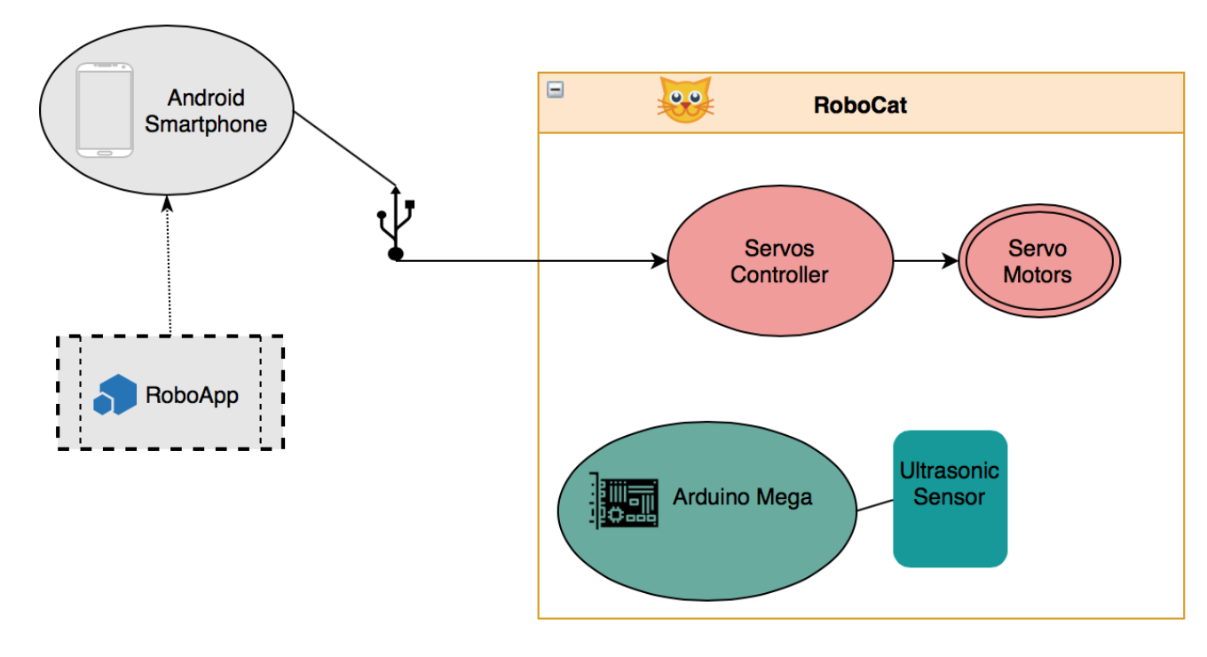
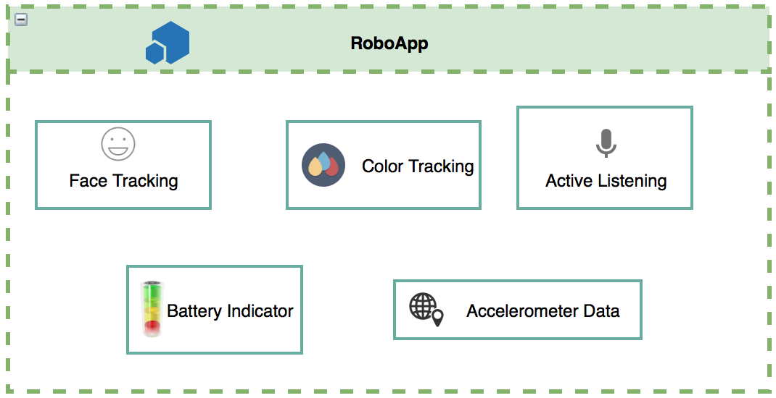
System Architecture

Slide 10
Implementation
See GitHub Documentation/Deliverables.

Slide 11
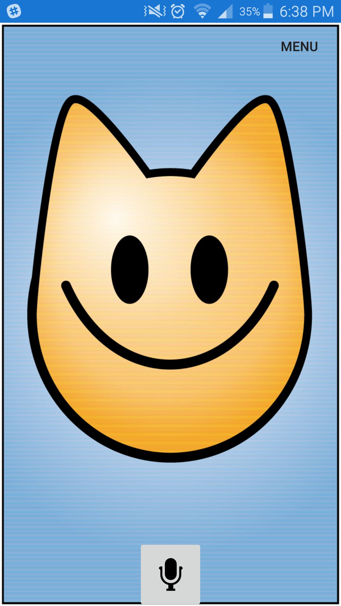
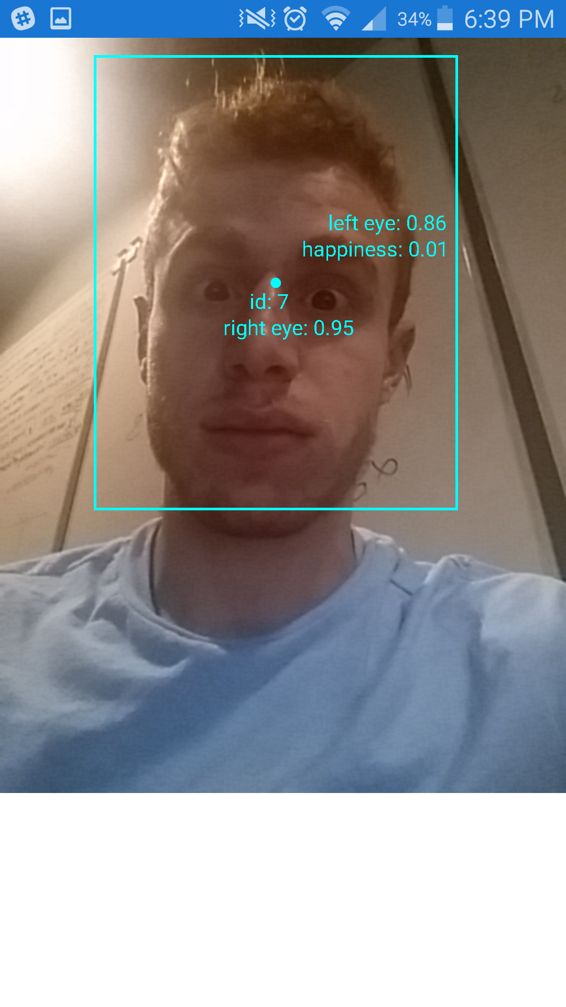


Build 4
Notes:
Don’t present - show late

Slide 12
New Milestone 4
Speech Recognition Team
Find some way to get volume data via constant listening
Get cat to respond to loud noises
Implement active listening fully
Facial Recognition Team
Fix head tracking code to accurately track Points of Interest
Full ability to move head to track faces and colors
Environmental Mapping Team
Develop map of the cat’s surroundings based on the distance data gathered by the ultrasonic sensor
Notes:
Present

Slide 13
Individual Contributions: Milestone 4
Speech Recognition Team:
Alex:
Removed OpenCV from the app
Implemented Pocketsphinx with all previous voice commands to allow continuous listening
Kurtis:
Made a command called “walk” that will allow the cat to walk for a certain period of time.
Notes:
Present

Slide 14
Individual Contributions: Milestone 3
Facial Recognition Team:
Quintin
Faces are now tracked accurately by the cat
Polish was added:
A rough distance measurement was used to determine what distance from the center of the camera was “good enough” for the cat. This eliminated head stuttering for close faces and bad centering for distant faces
New hardware allowed the FPS and resolution of the video to be increased, further improving accuracy.
Debugged permission handling for newer android operating systems
incorrect handling of multiple permissions at runtime caused the app to crash
Cleaned code, documented face tracking
Notes:
Present

Slide 15
Individual Contributions: Milestone 4
Facial Recognition Team:
Lukas
Restructured color-tracking to work with video feed.
Changed color-tracking to constantly loop.
Screen coordinates pointing to color are returned after every iteration.
Notes:
Present

Slide 16
Individual Contributions: Milestone 4
Environmental Mapping Team:
Seattle:
Worked on actor, concept/purpose mapping, diagrams and description of technology
Finishing up logging accelerometer data (displayed on button)
Zach
Added capability for the app to communicate with Arduino
only runs as second activity off the menu for now, once arduino is installed on cat, it will be moved to the background of the main activity
Notes:
Present

Slide 17
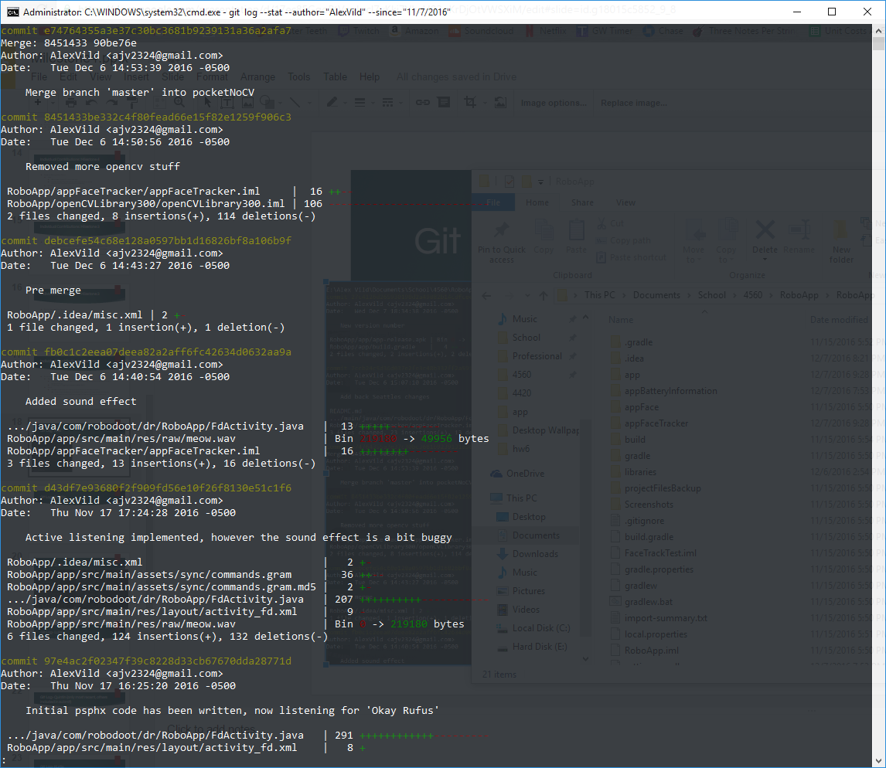
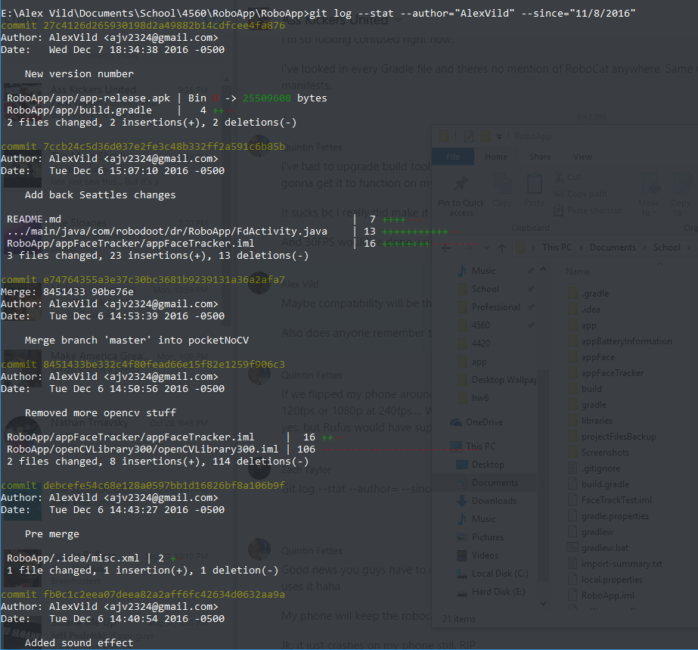
Git Log- Alex

Slide 18
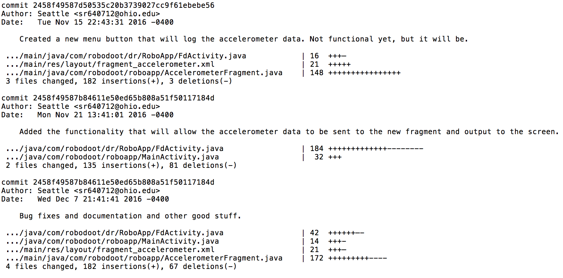
Git Log- Seattle

Slide 19
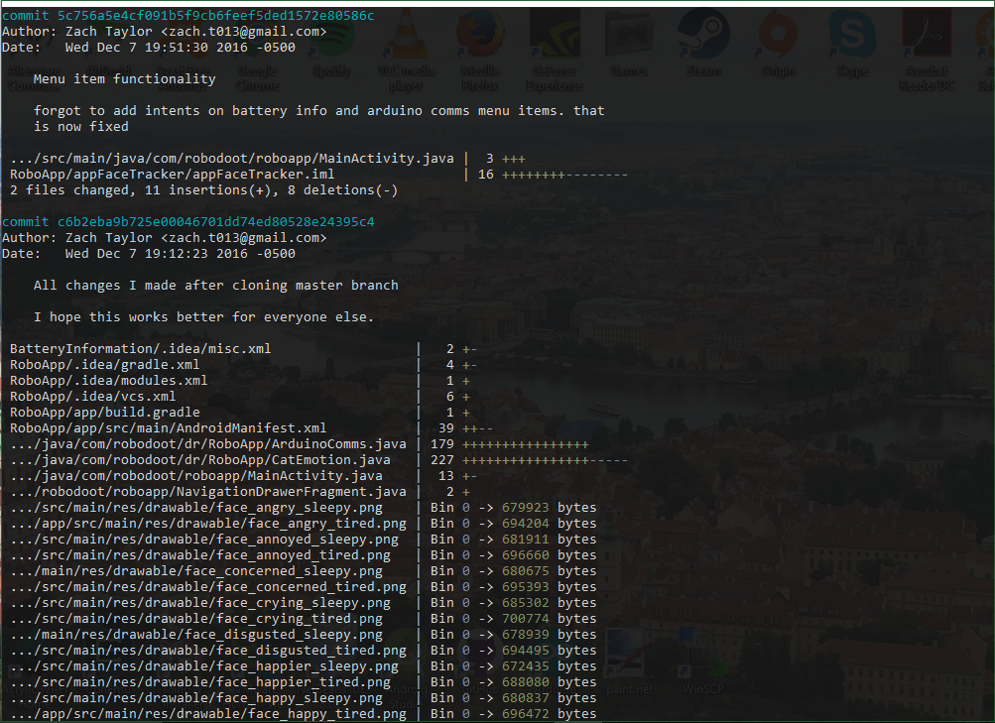
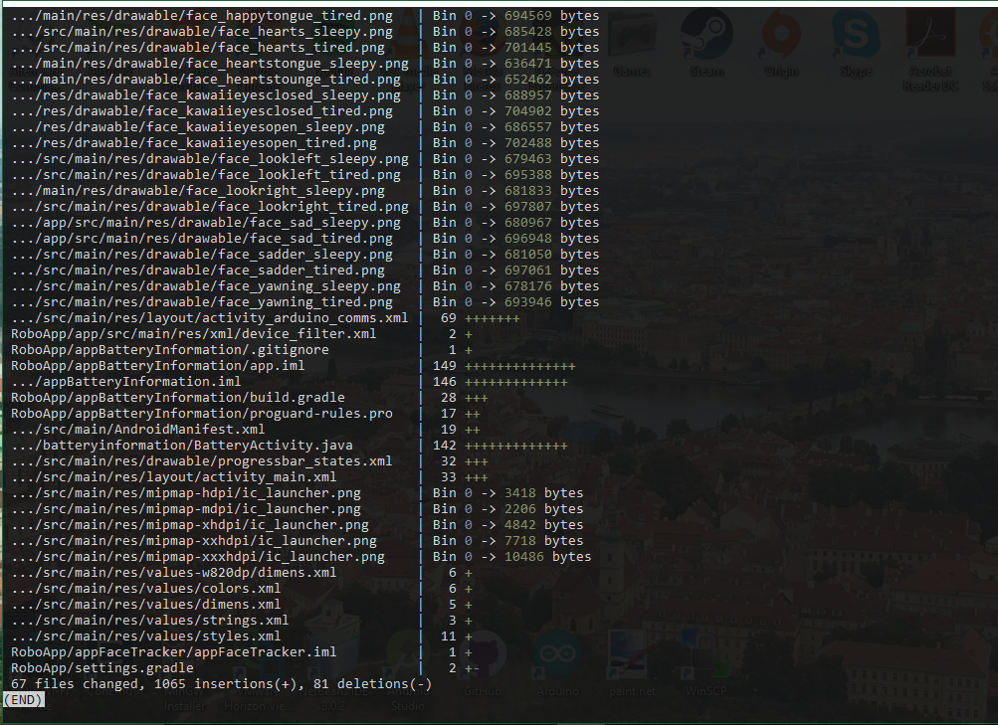
Git Log- Zach

Slide 20
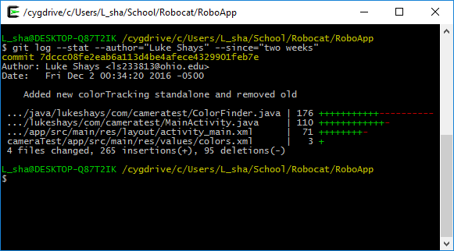
Git Log- Luke

Slide 21
Git Log- Quintin (only most recent, others included in submit)
see submitted file

Slide 22
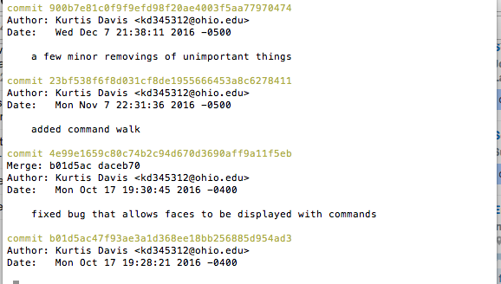
Git Log- Kurtis

Slide 23
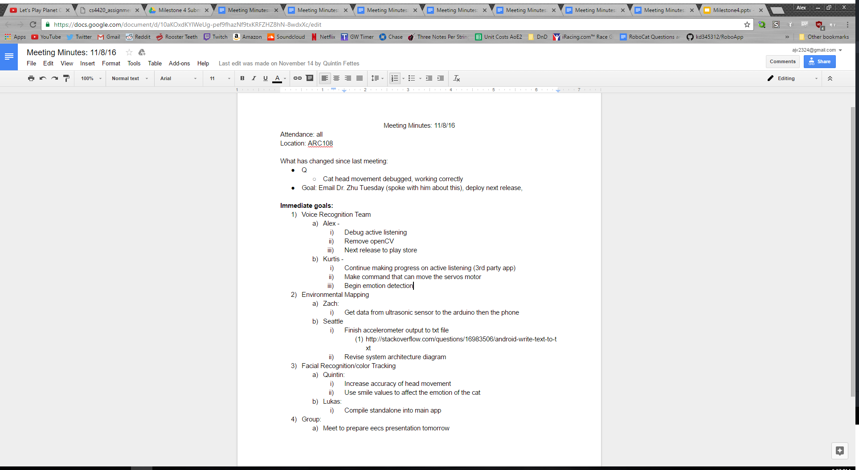
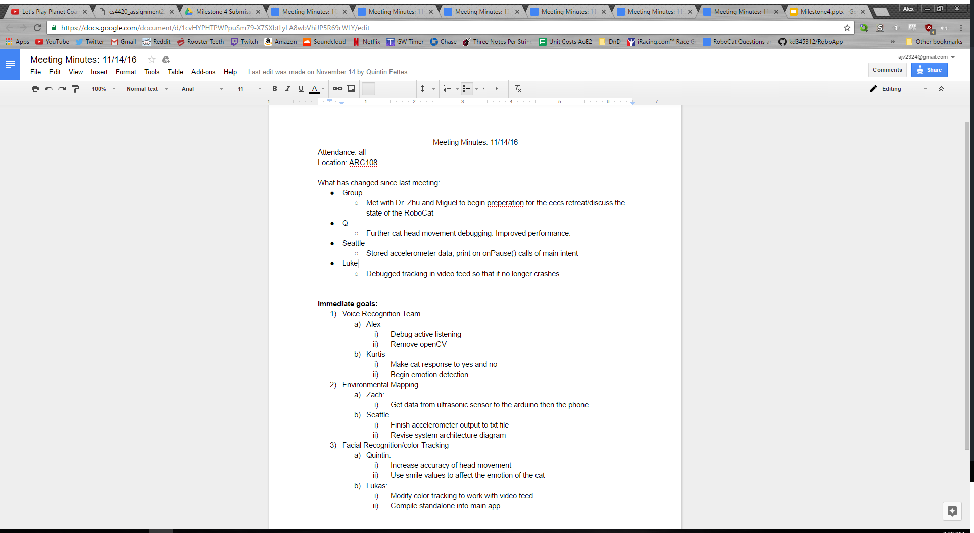
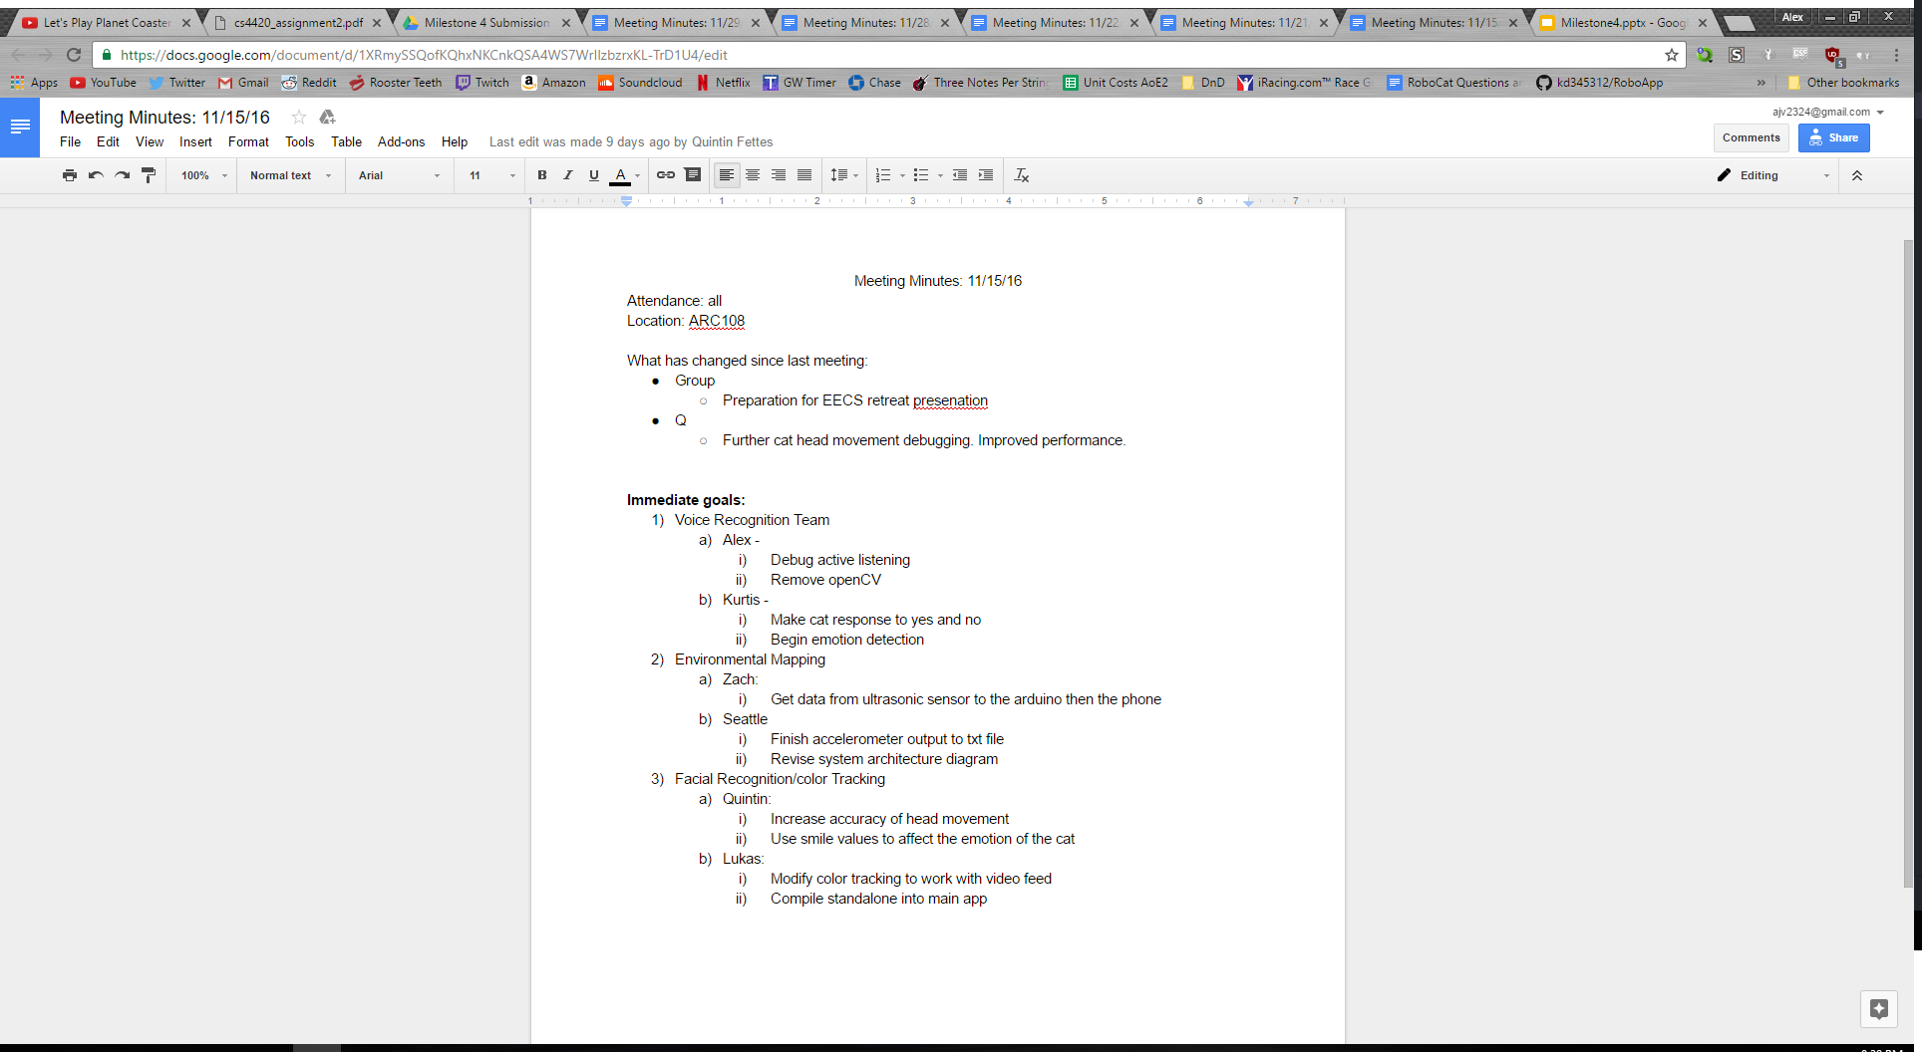
Meetings

Slide 24
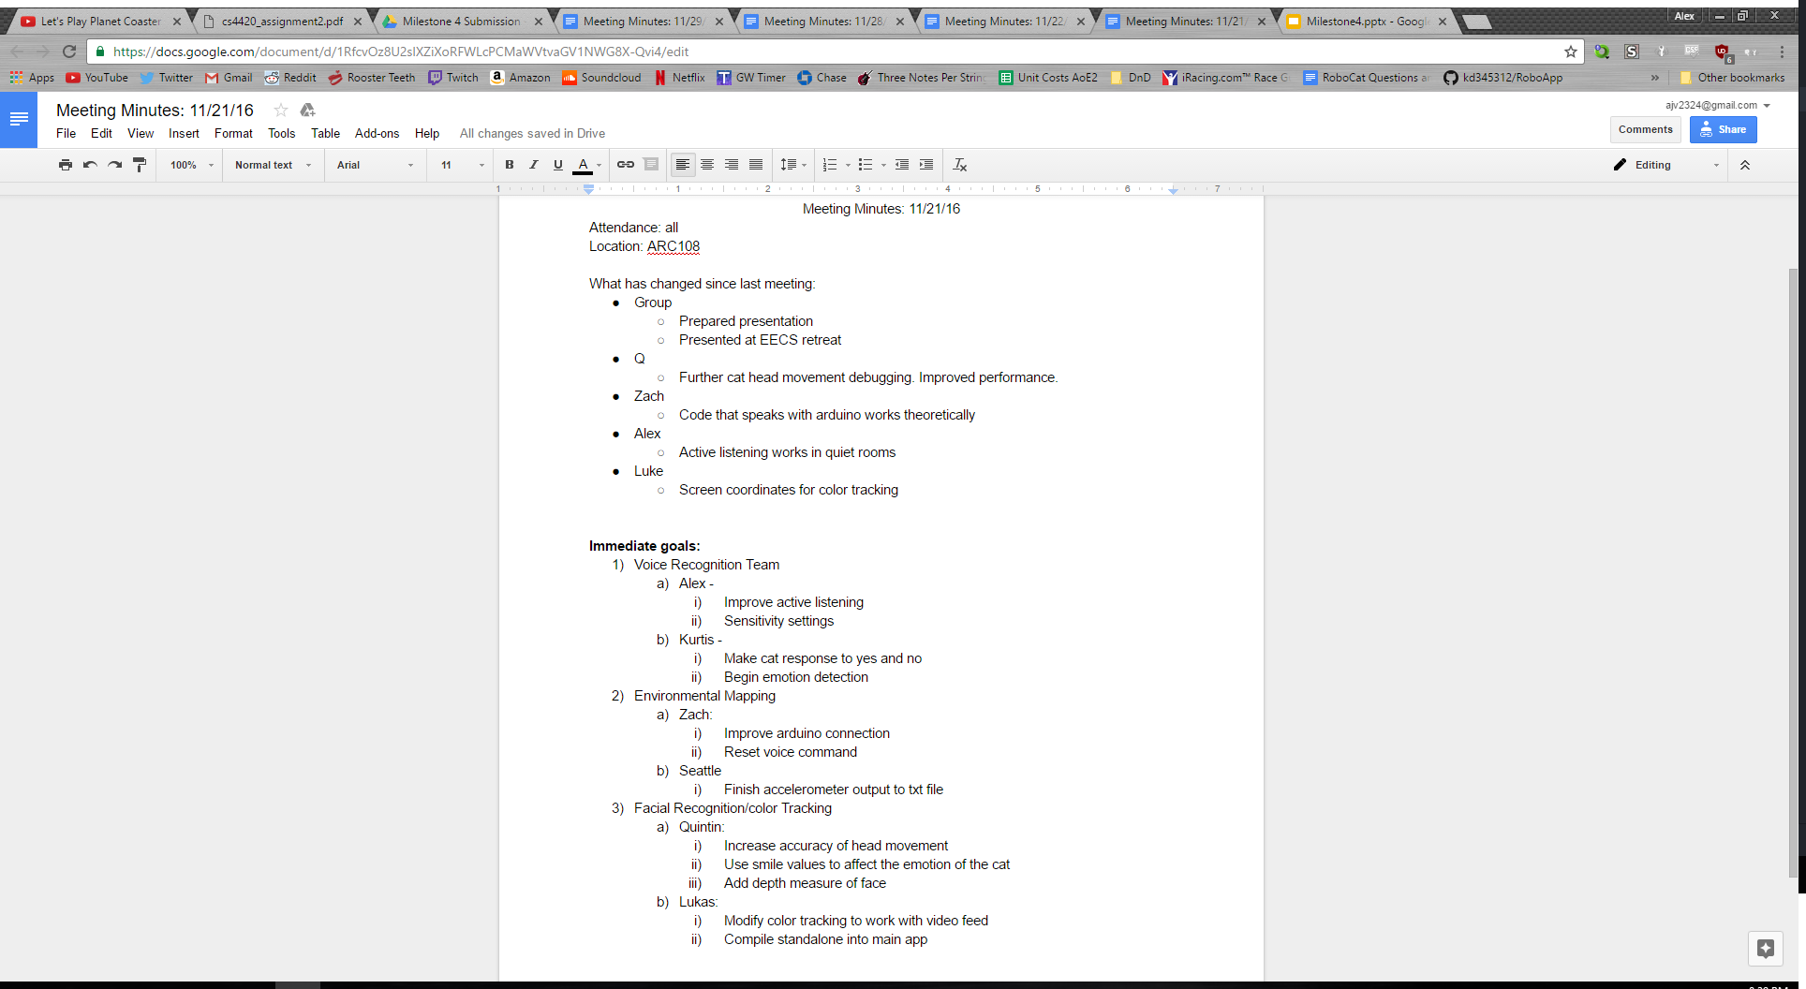
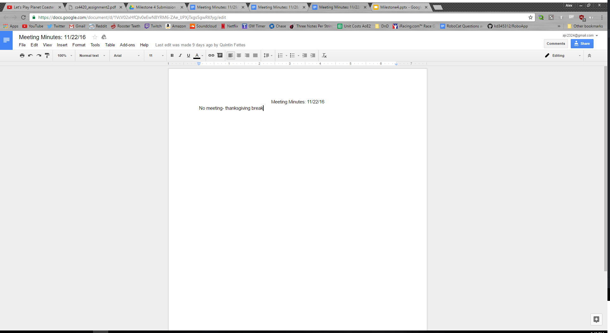
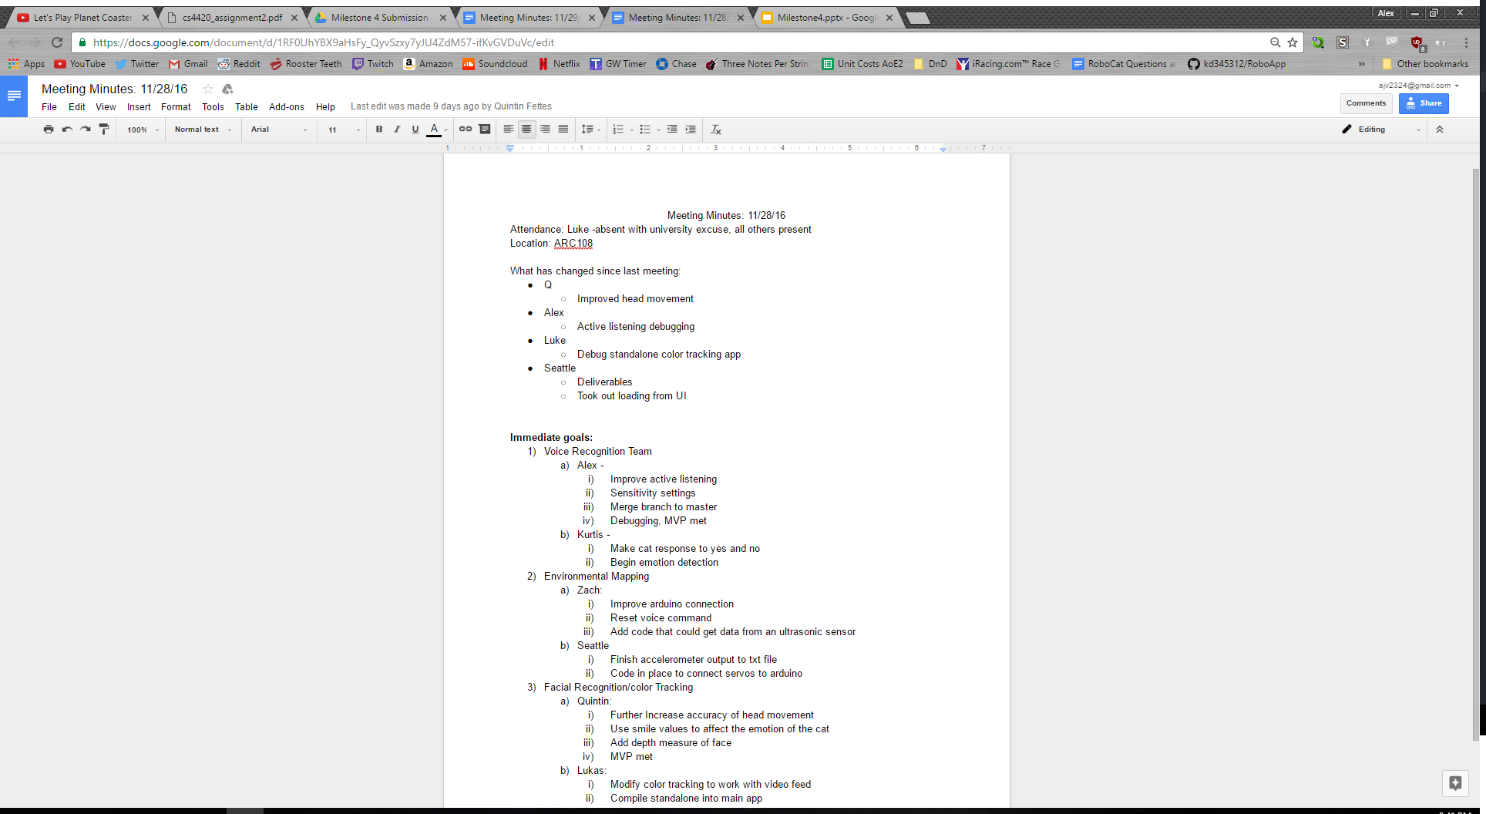
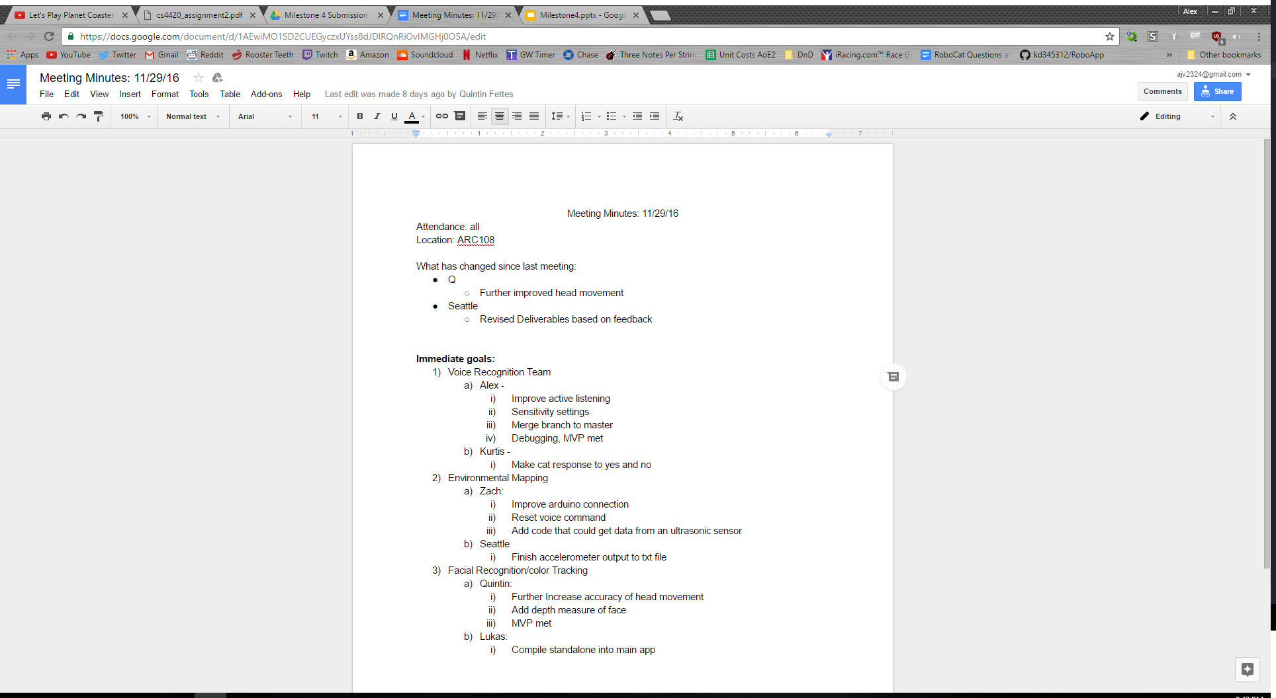
Meetings

Slide 25
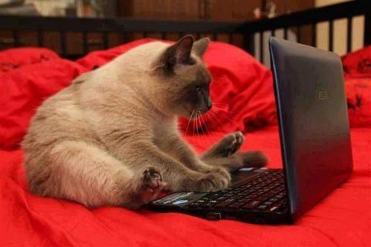
RoboCat Project
Notes:
Introduce ourselves

Slide 26
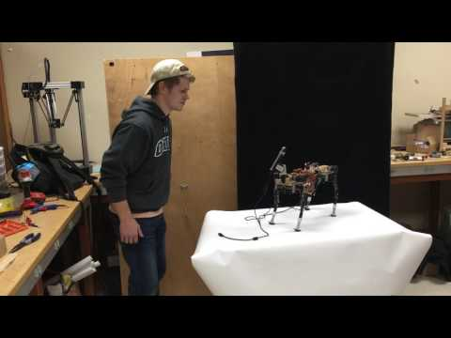
Demo: Face Tracking

Slide 27
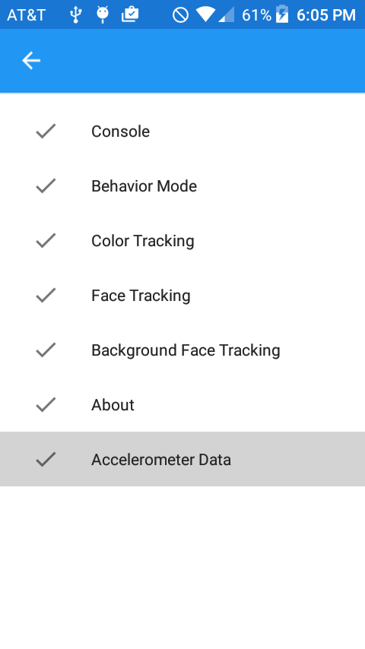
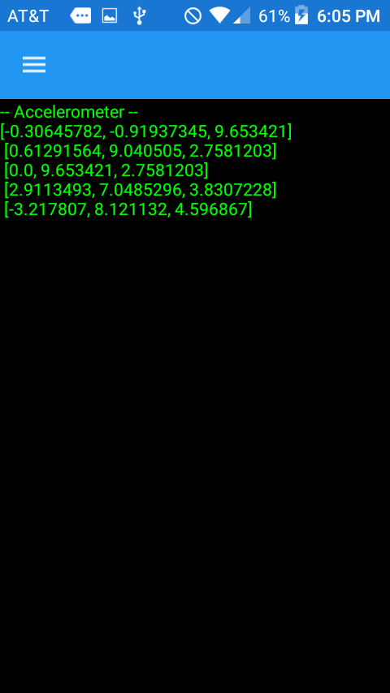
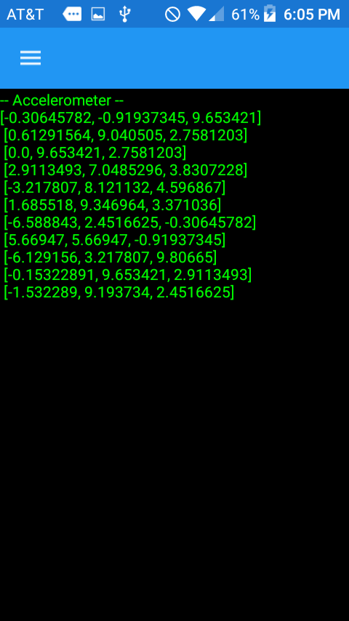
Demo: Accelerometer Data Output

Slide 28
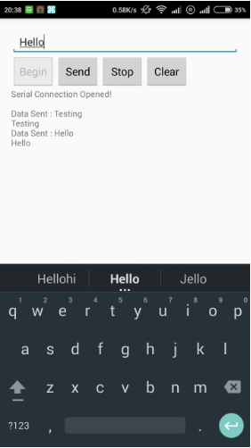
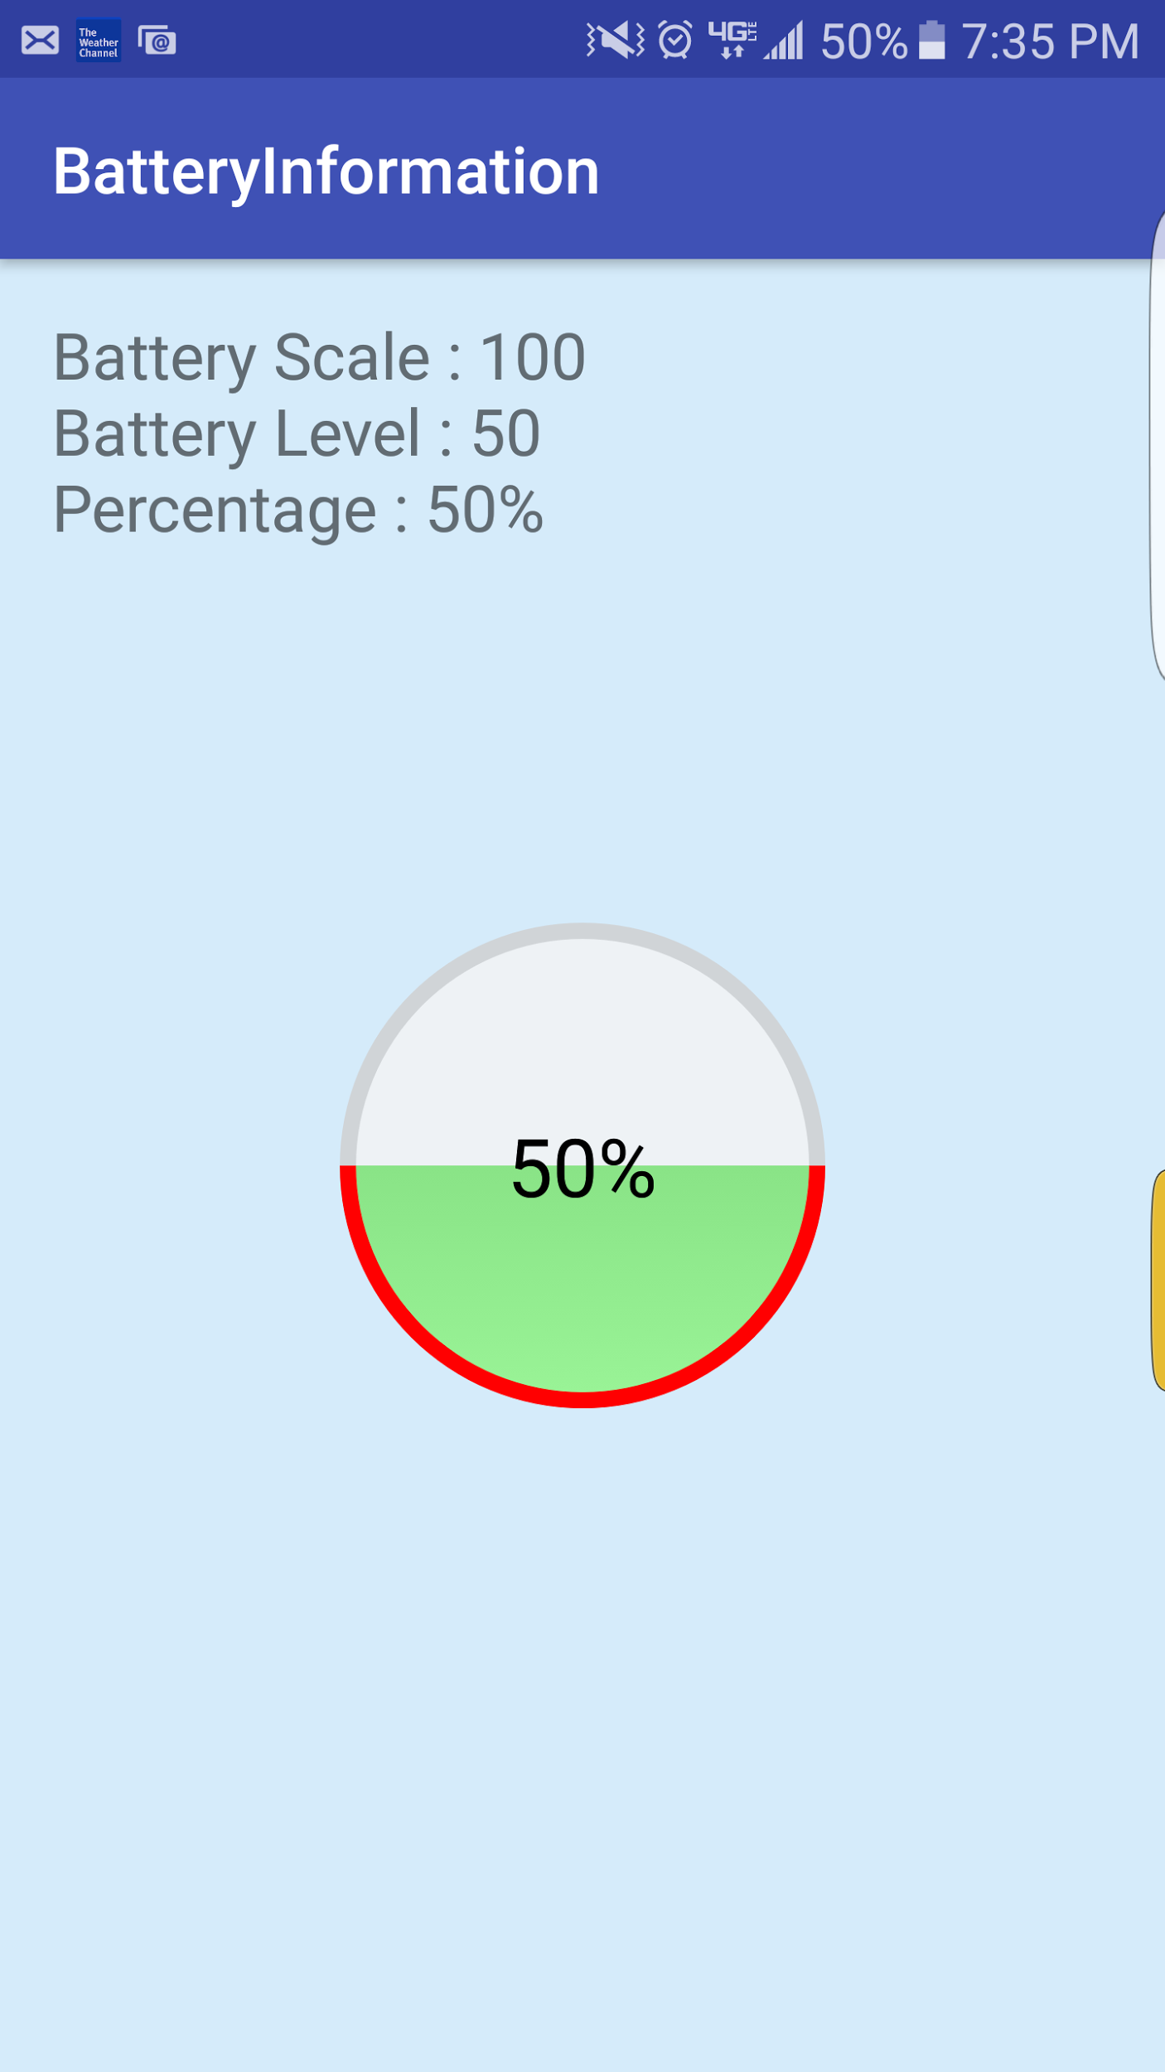
Demo: Arduino Communication and Battery Indicator

Slide 29
Demo
alex do active listening

